Slide 1

T-Test, Simple Linear Regression & Multi-Linear Regression
Submitted by:
Nithin Thomas

Slide 2

Content of Presentation
Description of Research
Key Statistics and Findings
T-Testing
Simple Linear Regression Model
Multiple Linear Regression Model
Conclusion
Reference

Slide 3
Description of Research
Mr. John Hughes has been collecting data on the effect of personal attributes on household expenses and would like to understand the following:
Conduct a T-test that the mean for expenses is equal to 10,000
The effect of smoking on expenses by creating a linear regression model
The effect of all input variables on expenses by creating a multivariate regression model
We will be providing a sample summary, t-test, linear and multi linear regression

Slide 4
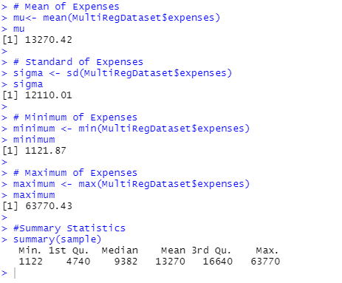
Key Statistics and Findings
Minimum expenses is 1121.87 and maximum value is 63770.43, which implies that there is a huge difference in the expenditure.
Mean value of expense is 13270 and median value is 9382, i.e. mean is greater than median which implies that the datapoints are not normally distributed and will be positively or right-skewed.
Standard deviation of expenses 12110.01 which is high which implies that the datapoints in our dataset are not clustered around the mean.
Figure 1.1 Basic Statistics

Slide 5
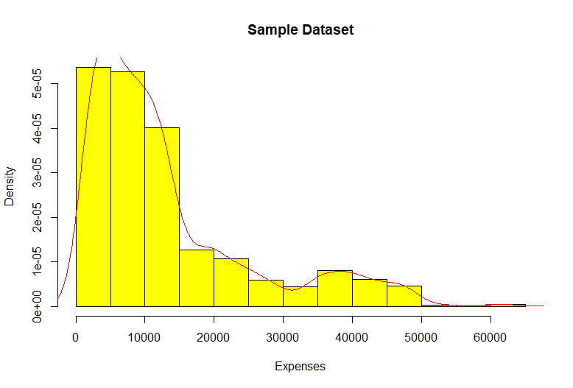
Histogram of Expense Data
Figure 1.2 Histogram of Expense
From the histogram, we can see that the distribution of datapoints is positively skewed.
Mean value of expense is 13270

Slide 6
Hypothesis for T-Testing
We need to check if the mean of expenses is equal to 10000.
Null Hypotheses, H₀: There is no significant change in mean expenses (i.e., mean expense is equal to 10,000),H_{o}: μ_{s}=10000
Alternative Hypotheses, H₁: There is significant change in mean expenses (i.e., mean expense is not equal to 10,000), H₁: μ_{s} ≠ 10000

Slide 7
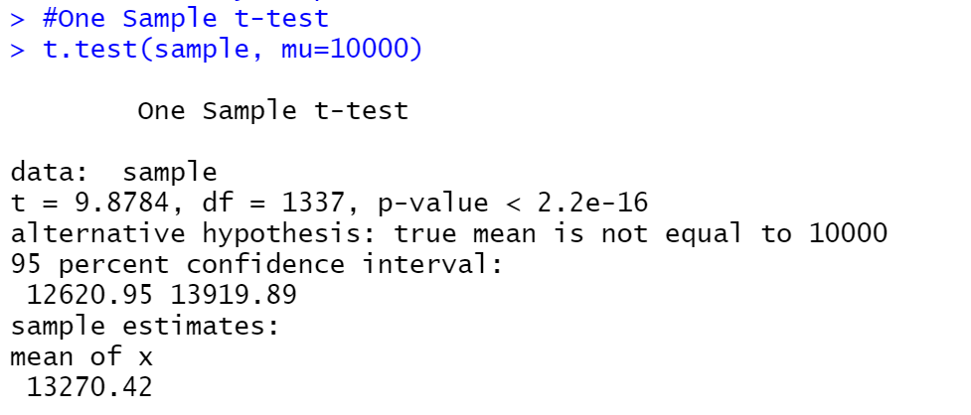
T-Testing Result
Figure 1.3 One sample t-test
From t-testing, the 95% confidence interval is found to be 12620.95 and 13919.89.
Mean value of expenses is 13270.42.
Since P-Value of 9.651e-05 is much lower than 0.05 confidence interval, therefore we reject the Null hypothesis(H₀), that μ = 10000. Hence, we accept the alternative hypothesis that μ ≠10000. Thus, we can conclude that there is a significant change in mean expense on analyzed data.
Note: Normally, we use t-test to compare small sample set which might be less than 30 in number and because of this reason, we may not say that t-test we conducted will be accurate.

Slide 8
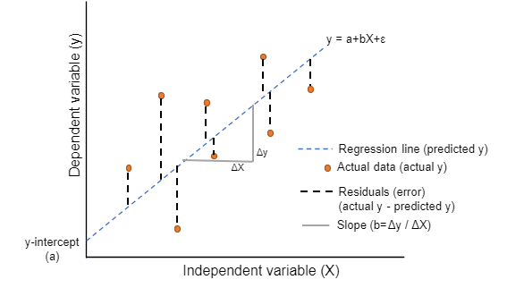
Simple Linear Regression Model
This analysis is carried using Linear Regression to predict the value of an outcome of dependent variable Y using one or more independent predictor variables X
y = a + bX + ϵ
This method calculates the best-fitting line for the observed data by minimizing the sum of the squares of the vertical deviations from each data point to the line.
To view the fit of the model to the observed data, one may plot the computed regression line over the actual data points to evaluate the results.
a is the intercept & b is the slope and are called regression coefficients.
ϵ is the error term, the part of Y the regression model is unable to explain.
y is dependent variable
X is independent variable
Figure 1.4 Linear Regression

Slide 9
Hypothesis Statements of Simple Linear Regression Model
Null hypothesis
H₀: β=0, i.e., the co-efficient β of the predictor is zero and is not statistically significant. In other words, relationship between expenses and smoker doesn’t exist.
Alternative hypothesis
H_{a} : β≠0, i.e., the co-efficient β of the predictor is not equal zero and it’s statistically significant. In other words, relationship between expenses and smoker doesn’t exist.

Slide 10
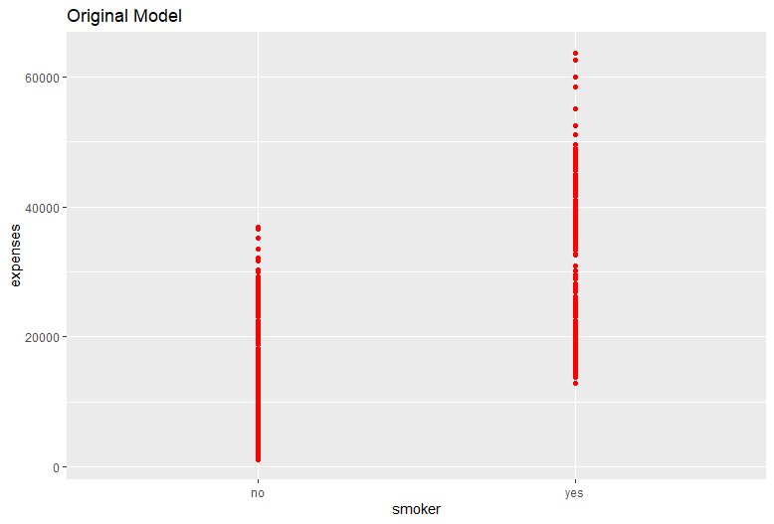
R Script used for the analysis
#linear Regression
#Dependent Variable
y <- MultiRegDataset$expenses
#Independent variable
x <- MultiRegDataset$smoker
#ggplot
ggplot(MultiRegDataset, aes(x = MultiRegDataset$smoker, y = MultiRegDataset$expenses))+ geom_point(colour = "red") + geom_smooth(method = "lm", fill = NA) + labs(title = "Original Model",x = "smoker",y = "expenses")
Output

Slide 11
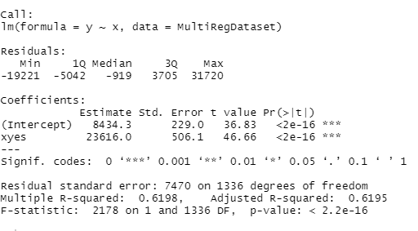
R Script used for the analysis
#Simple Regression Model
simple.fit<-lm(y ~ x, data = MultiRegDataset)
LinearModel<-simple.fit
summary(LinearModel)
Output of Simple Linear Regression

Slide 12
Interpretation and Evaluation from the Testing
Considering the simple regression model testing, the Multiple R-Squared value is found out to be 0.00204 or 0.2%. It suggests that the model failed to explain the variability of the response data around its mean.
The p-value is found to be less than 2.2e-16, which is lesser than 0.05 significance level, hence we reject the null hypothesis(H₀) and accept the alternative hypothesis(H₁) which implies that there is a significant relation between smoker and expenses, which are the independent and dependent variables, respectively.
Equation for Regression Model is:
Y(Expenses)= 8434.3 + 23616* X(Smoker) + error.
From the model, we can say that if the person is a smoker, that is, when X=1, then according to our predicted model, his Expense = 8434.3 + 23616* 1+ error
In the other way, if the person is a not a smoker, that is if X= 0 then, Expense = 8434.3 + 23616* 0+ error
Since our independent variable is categorical in nature, we will have only two outcomes for the predicted value of Y.
The maximum value of 31720 shows that there is a point which lies far above from the predicted regression line and minimum value of -19221 shows that there is a point lies far below the predicted regression line.

Slide 13
Multiple Linear Regression Model
Multiple linear regression (MLR), also known simply as multiple regression, is a statistical technique that uses several explanatory variables to predict the outcome of a response variable.
Multiple regression is an extension of linear (OLS) regression that uses just one explanatory variable.
MLR is used extensively in econometrics and financial inference.
The equation is given below:
y= β₀ + β₁X₁ + β₂X₂₊ ….+ β_{i}X_{i} + ϵ, where i = 1,2, ..., n
where, y = Independent variable
X_{i} = Dependent variable
ϵ = Error
β₀ = y-intercept
β_{i} = Slope

Slide 14
Hypotheses for Multiple Linear Regression Model
Null Hypotheses:
H0 : age= sex=children=BMI =smoker=region=0
i.e., The initial assumption is that there is no relation, which is expressed as: H0: β1 = β2 = … = βp-1 =0.
Alternative Hypothesis:
H1 : at least one βi ≠ 0 (for i = 1, 2, 3)
i.e., At least one of the independent variables is useful in explaining/predicting Y

Slide 15
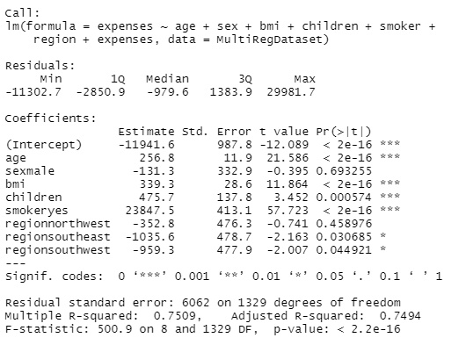
R Script used for the analysis
#Multi Linear Regression
data(MultiRegDataset)
MultiRegDataset
#Create Dataset
input <- MultiRegDataset[,c("age","sex","bmi","children","smoker","region","expenses")]
print(head(input))
# Create the relationship model.
model <- lm(expenses~age+sex+bmi+children+smoker+region+expenses, data = MultiRegDataset)
#Model Summary
summary(model)
# Show the model.
print(model)
Output of Multiple Linear Regression

Slide 16
Interpretation and Evaluation from the Testing
Considering the adjusted regression model testing, the Adjusted R-Squared value is found out to be 0.74. or 74%. It suggests that the model can explain the variability of the response data around its mean.
The p-value is found to be less than 2.2e-16, which is lesser than 0.05 significance level, hence we reject the null hypothesis(H0) and accept the alternative hypothesis(H1).
Equation for Regression Model is:
Y(Expenses)= -11941.6 + 256.8 * age -131.3*sexmale + 475.7*children + 23847.5*smokeryes -352.8*regionnorthwest-1035.6*regionsoutheast-959.3 *regionsouthwest + error.
The maximum value of 29981.7 shows that there is a point which lies far above from the predicted regression line and minimum value of -11302.7 shows that there is a point lies far below the predicted regression line.

Slide 17
Conclusion for Multiple Linear Regression
Coefficient p-values is used to decide whether to include variables in the final model. Form the results, we would consider removing regionnorthwest and sexmale. Keeping variables that are not statistically significant can reduce the model’s precision.
The regression output example shows that the regionsoutheast and regionsouthwest predictor variables are statistically significant because their p-values equal 0.03 and 0.04 respectively. On the other hand, removing regionnorthwest and sexmale is not statistically significant because its p-value (0. 46, 0.69 respectively) is greater than the usual significance level of 0.05.

Slide 18
Conclusion
Multiple Linear Regression(MLR) model is better than the Simple Linear Regression model which had an adjusted R2 of 0.61 compared to 0.75 for the MLR.
We will be rejecting all Null hypotheses and accepting the alternate hypotheses for every testing we did.
Conclusion
Thus we suggest Mr. John Hughes to go with Multiple Linear Regression Model rather than Simple Linear Regression Model because variability is explained more accurately in MLR model

Slide 19
Reference
Week12, Week13-Data1204 Slides from DC connect -> Course content

Slide 20


